Slide 1

Lesson One: How have Bradford’s buildings changed over time?
Key Stage 2: History
Learning Aims and Outcomes
Pupils will explore the reasons for the changes in a range of historic buildings in the same location across time
Pupils will use clothes/uniforms as an analogy for how buildings change their appearance depending on their use
Pupils will learn how specific buildings changed their use and use labels to record these changes on a diagram
Pupils will use their evidence to debate which of the buildings shows the most change over time.
This activity relates to the Teaching Activity: Stories in Stone - How & why has Bradford changed over time?
Notes:
Learning Objective
To explore the immediate reasons for changes in a range of historic buildings in the same location across time
Learning outcomes: Pupils will have
Considered how clothes sometimes act as uniforms for particular occupations as an analogy for how buildings change their appearance depending on their use
Read the history of changes of use in a range of historic Bradford buildings
Recorded these changes of use on a diagram
Selected generic labels describing the types of use of each building over time and added these to the diagram
Used the diagram to debate which building shows evidence of the most change

Slide 2
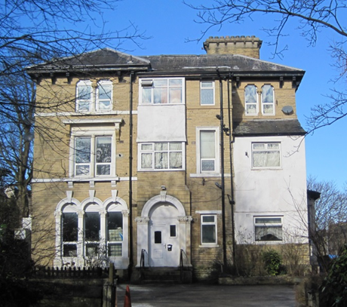
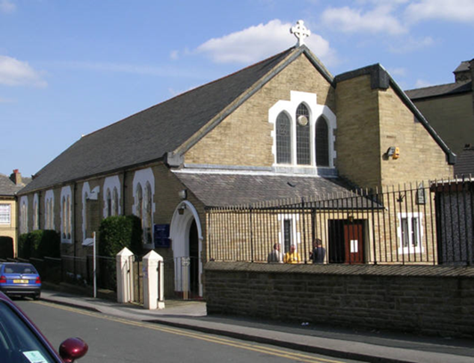
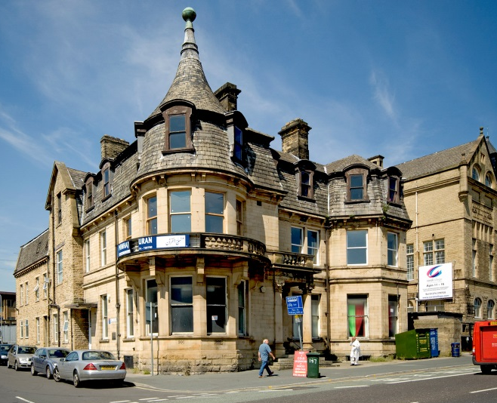
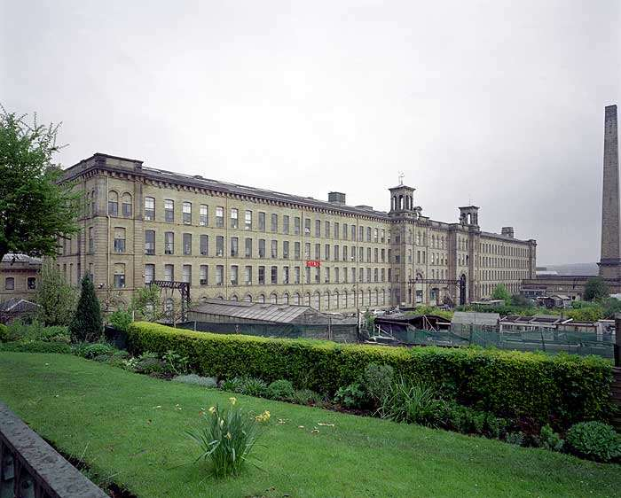
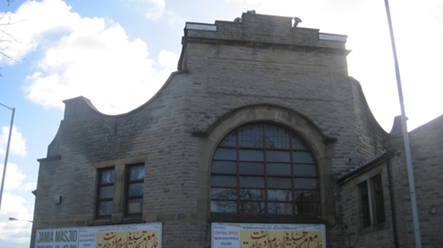
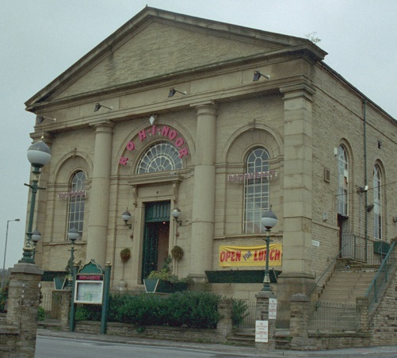
How have Bradford buildings changed over time?
Notes:
Pupils will explore the reasons for the changes in a range of historic buildings in the same location across time

Slide 3
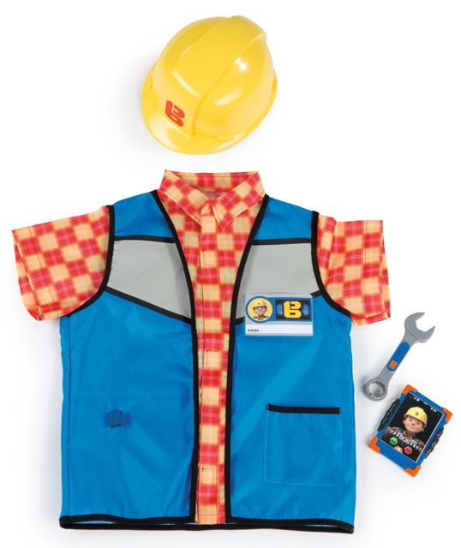
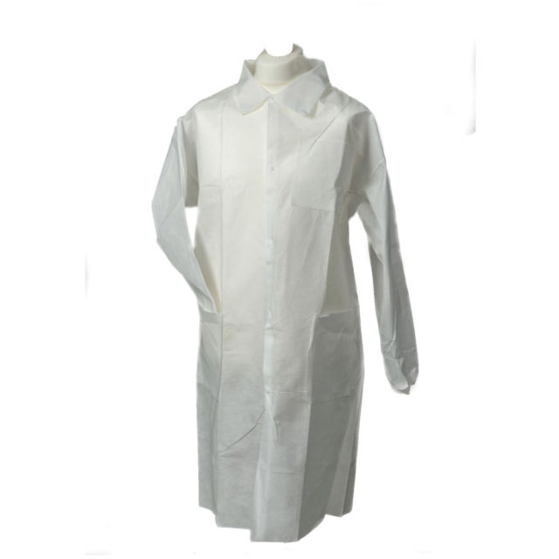

What might these people do?
Notes:
Starter Activity
Ask a pupil to stand in front of the class and put on three different hats or costumes in turn that might indicate different occupations (e.g. a builder’s helmet, a scientist’s or doctor’s white coat, a nurse’s uniform etc. - these could be fancy dress).
Take comments about what might need to change about the individual people in order for them to be able to do that job i.e. they would need knowledge, training and experience.
Make the point however that they would still be the same person with the same body even if the way they dress and what they did for a job were different. (The images of child costumes above could also be used).

Slide 4
How would a school need to change to become……
A cinema with a restaurant
A block of flats
A place of worship (church, mosque, temple etc.)
A hospital
A hotel
A theatre
Split into 6 groups, one for each building type. Then use the floor plan on the next slide to redesign the school into each type of building.
Notes:
Main Activity 1 – How can buildings change use
Explain that buildings can be like people - they can remain basically the same but can change what they are used for like a person who moves from one job to another might change the way they dress.
As well as the floor plans on the following slides you can also give each group a copy of the slide with images for their building type on (slides 8-13).

Slide 5
How would a school need to change to become……
Classroom
Girl’s
Toilets
Boy’s
Toilets
Classroom
Playground
Classroom
Corridor
Corridor
Classroom
Classroom
Hall
Classroom
Reception
Notes:
Plan of a school for children to redesign as their chosen type of building
Give small groups a copy of the ground plan of a school – or even use a real one of your own school!
Allow a limited amount of time for each group to sketch roughly on their plans how the school building might need to be changed for one of the building types listed. (Explain that walls can be knocked down or put in, doorways and windows changed, equipment and furniture changed, decorations and displays changed)

Slide 6
How would a school need to change to become……
If my school was a……….…………………………………...it would look like this
Notes:
Plan with walls to print for children to write on
Give small groups a copy of the ground plan of a school – or even use a real one of your own school!
Explain that buildings can be like people - they can remain basically the same but can change what they are used for like a person who moves from one job to another might change the way they dress.
Allow a limited amount of time for each group to sketch roughly on their plans how the school building might need to be changed for one of the building types listed. (Explain that walls can be knocked down or put in, doorways and windows changed, equipment and furniture changed, decorations and displays changed)

Slide 7
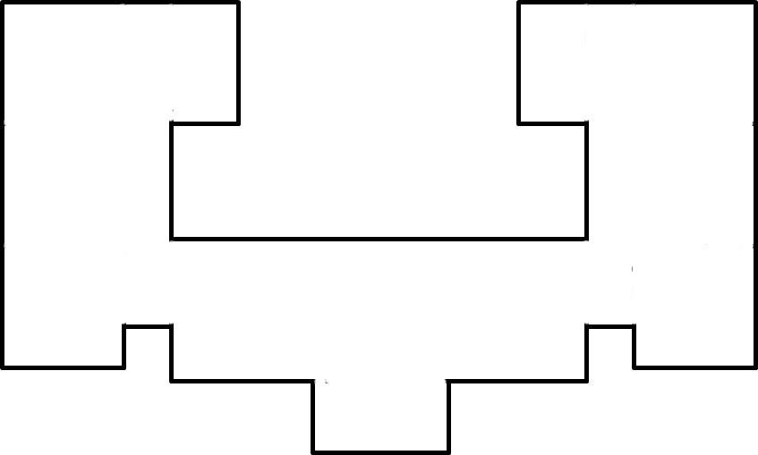
How would a school need to change to become……
If my school was a……….…………………………………...it would look like this
Notes:
Plan without walls to print for children to write on
Give small groups a copy of the ground plan of a school – or even use a real one of your own school!
Explain that buildings can be like people - they can remain basically the same but can change what they are used for like a person who moves from one job to another might change the way they dress.
Allow a limited amount of time for each group to sketch roughly on their plans how the school building might need to be changed for one of the building types listed. (Explain that walls can be knocked down or put in, doorways and windows changed, equipment and furniture changed, decorations and displays changed)

Slide 8
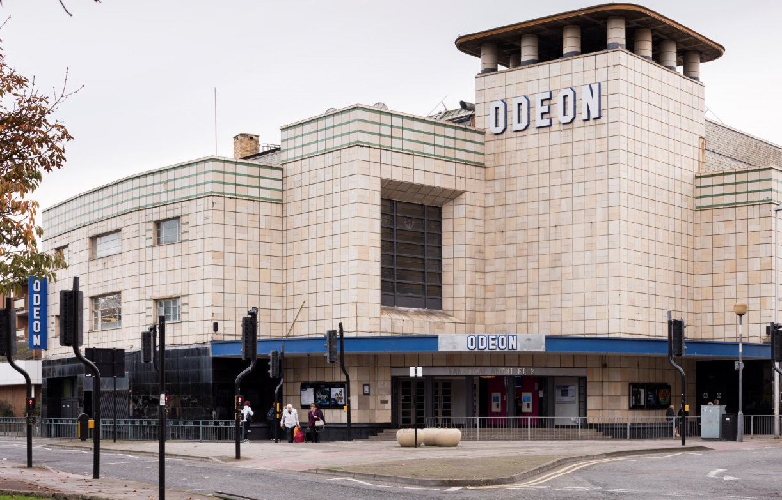
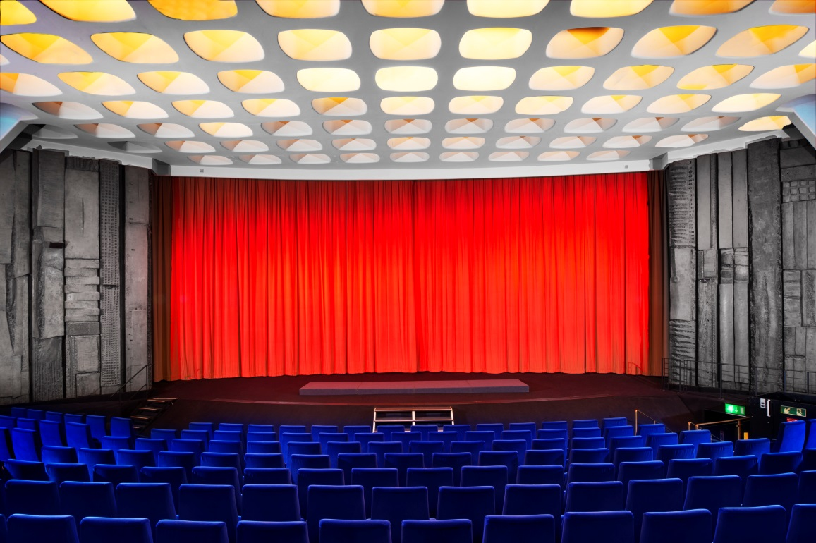
A cinema with a restaurant
Notes:
Print this slide to give the group redesigning the school plan as a cinema with a restaurant.
Images:
DP218304 & DP161828 © Historic England Archive

Slide 9
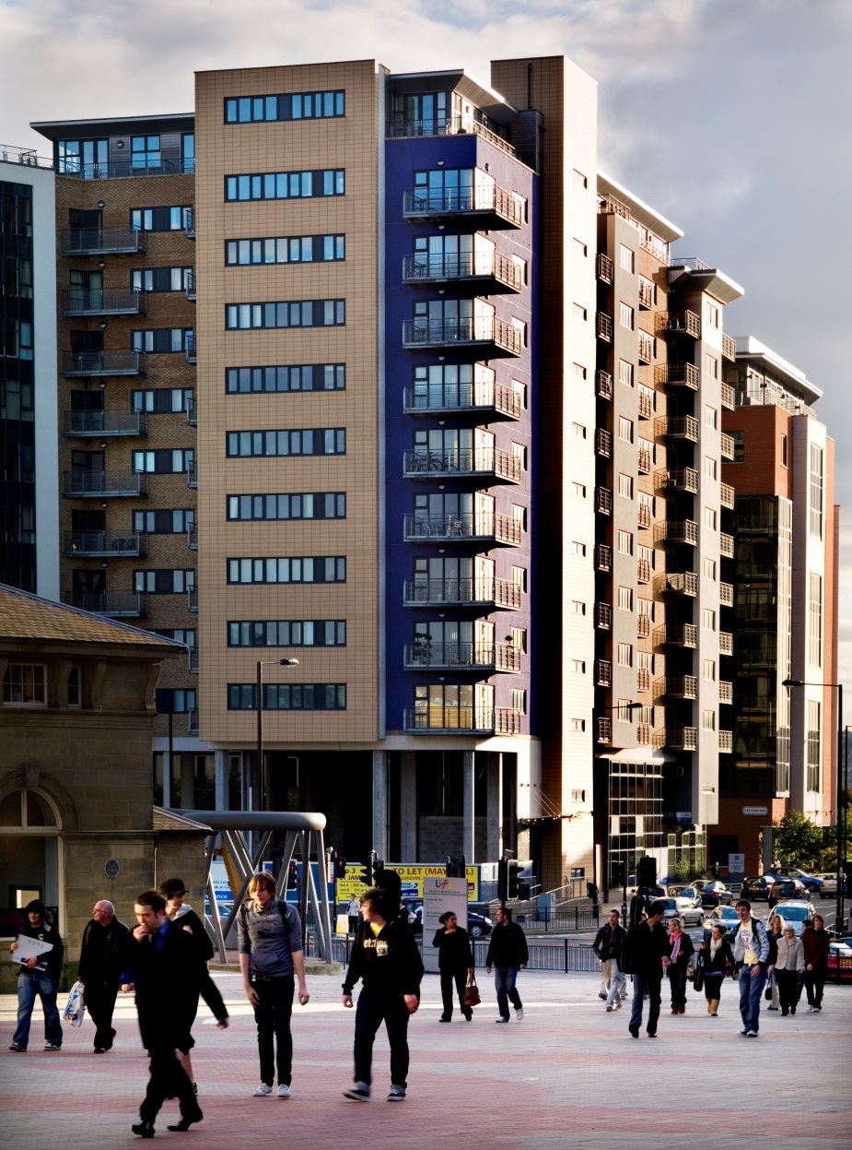
A block of flats
Notes:
Print this slide to give the group redesigning the school plan as a block of flats.
Images:
DP058473 & DP164774 © Historic England Archive

Slide 10
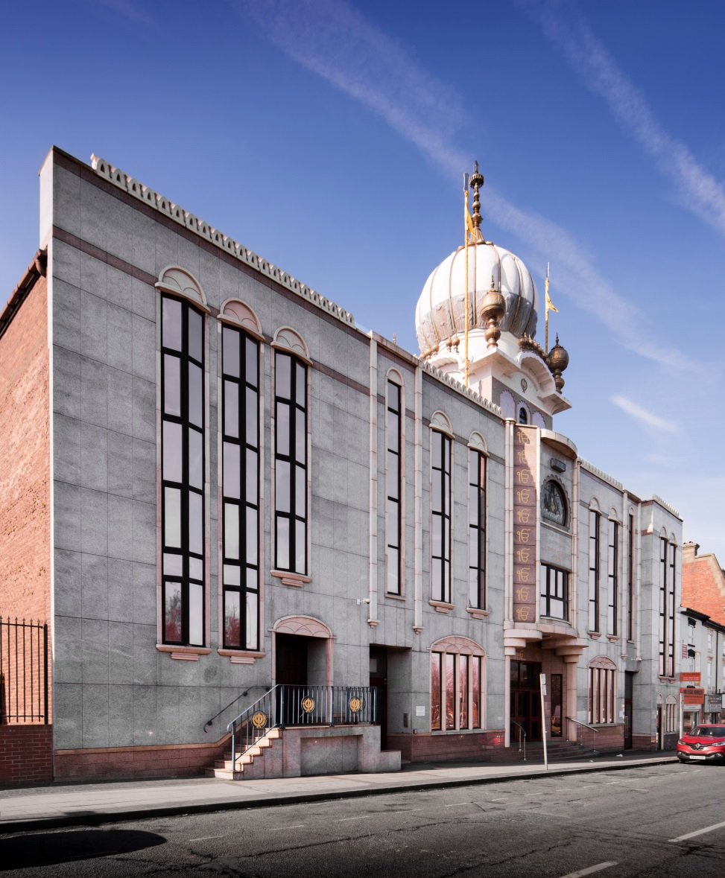
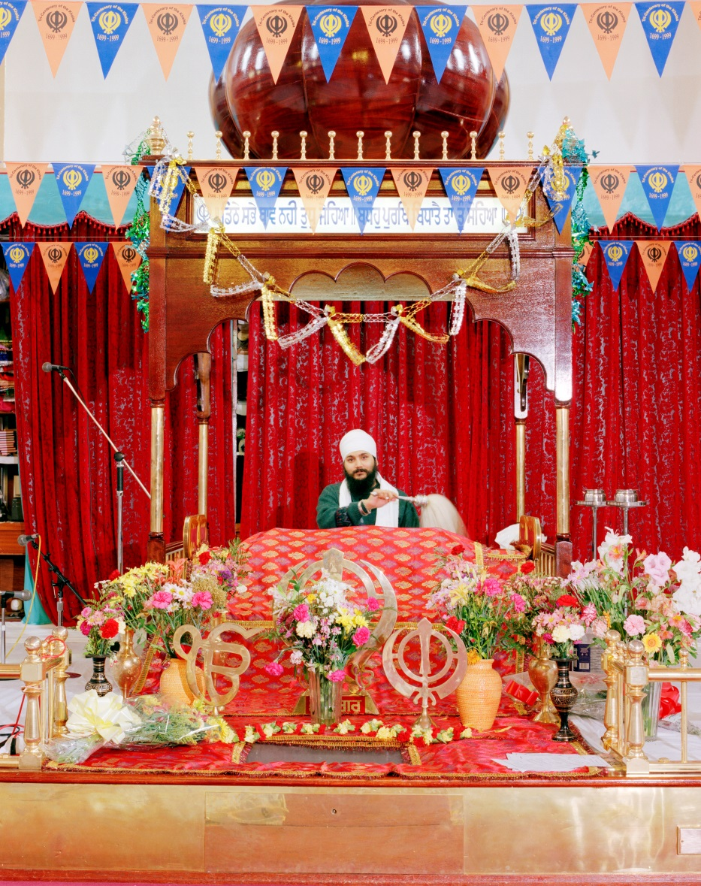
A place of worship
(e.g. a Sikh Temple)
Notes:
Print this slide to give the group redesigning the school plan as a place of worship.
Images:
DP220279 & AA99/08737 © Historic England Archive

Slide 11
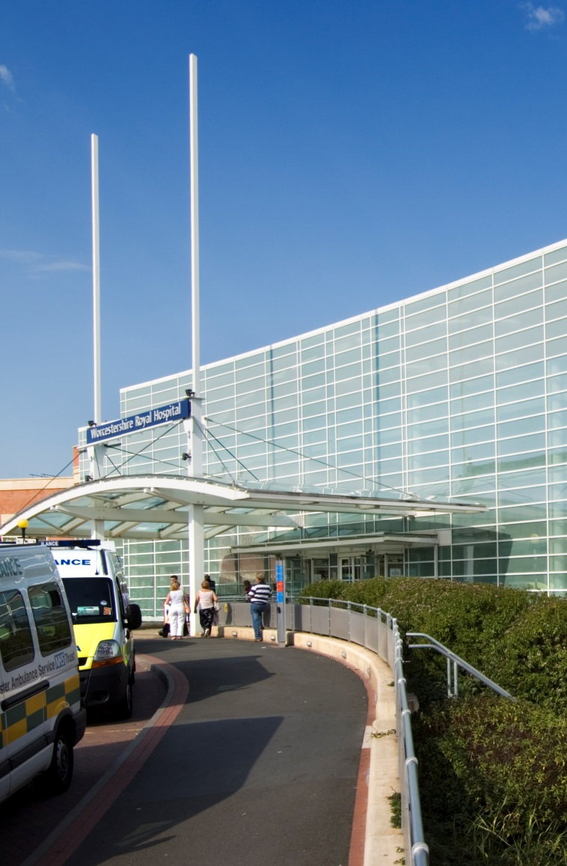
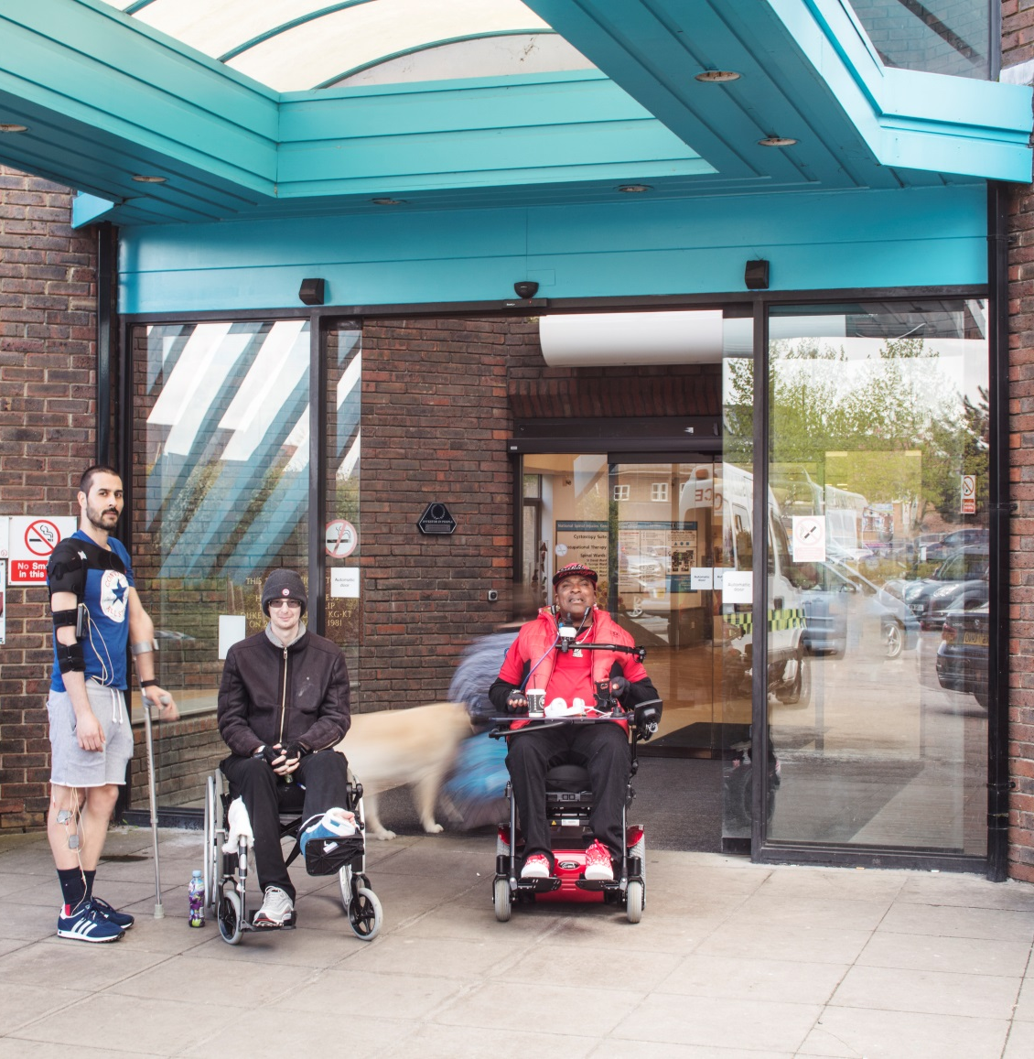
A hospital
Notes:
Print this slide to give the group redesigning the school plan as a hospital.
Images:
DP031149 & DP232079 © Historic England Archive

Slide 12
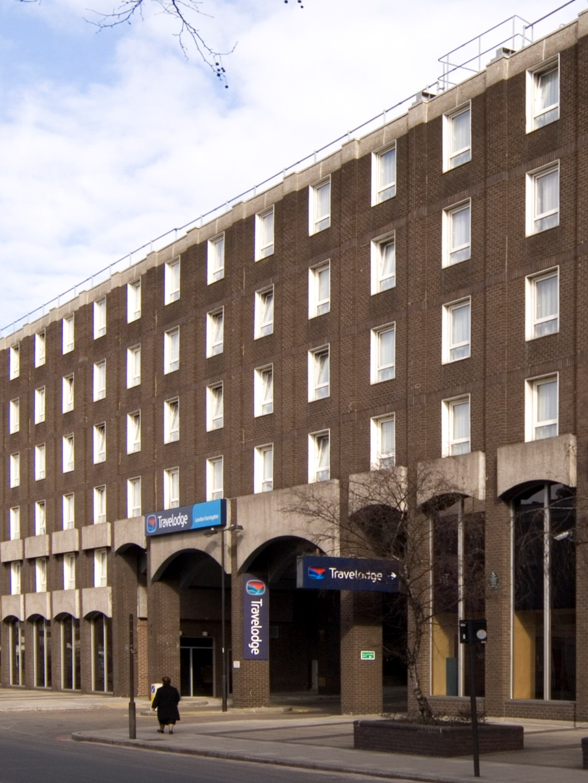
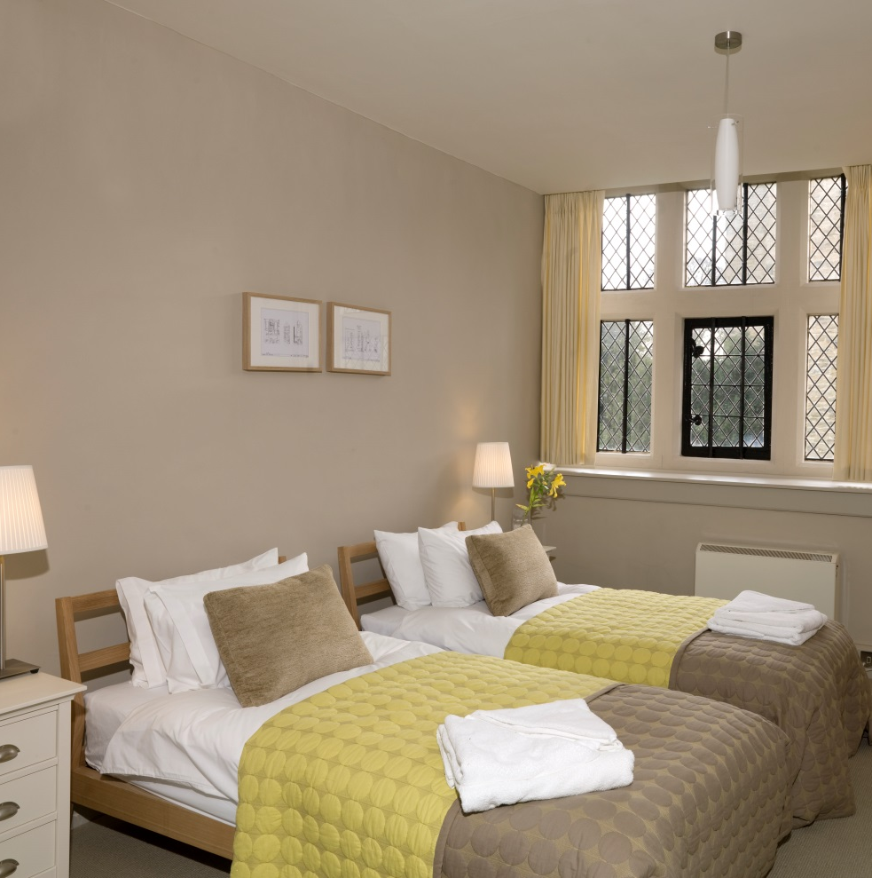
A hotel
Notes:
Print this slide to give the group redesigning the school plan as a hotel.
Images:
DP042020 & DP087339 © Historic England Archive

Slide 13
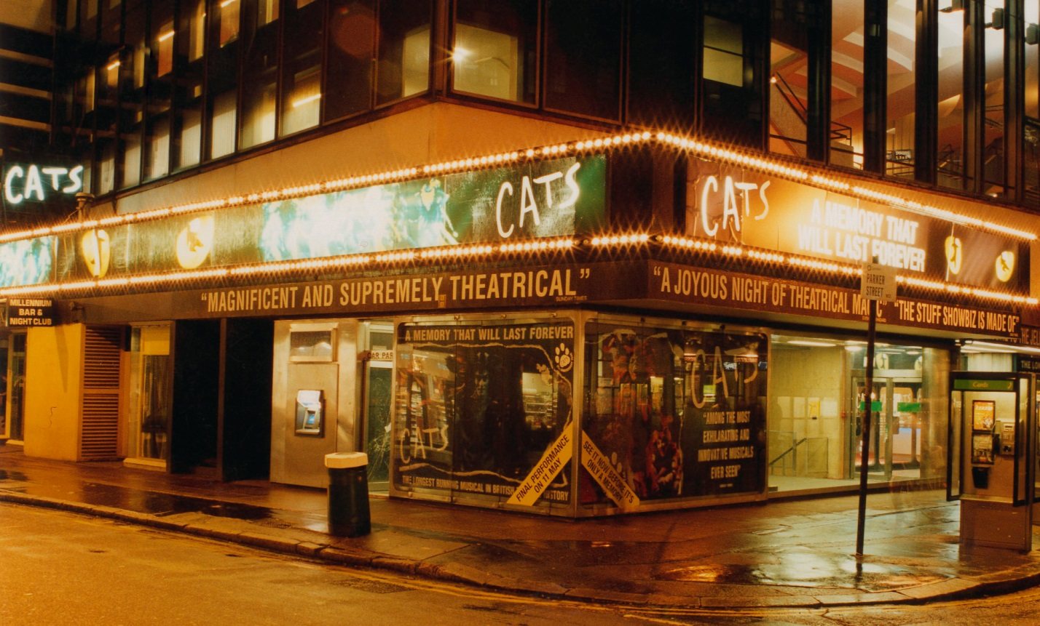
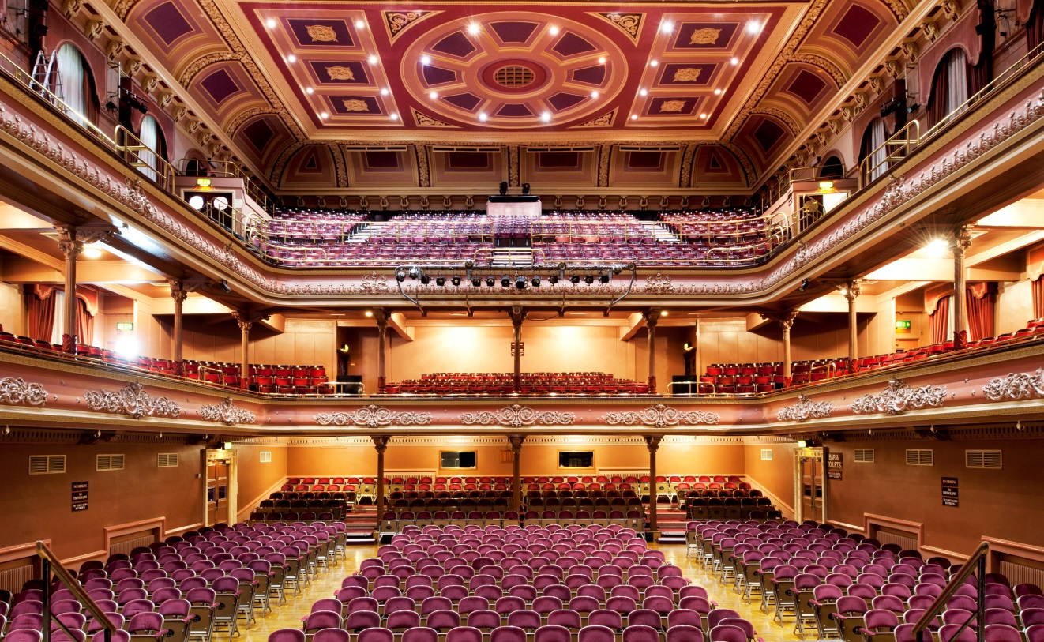
A theatre
Notes:
Print this slide to give the group redesigning the school plan as a theatre.
Images:
AA032021 & DP137918 © Historic England Archive

Slide 14
How would a school need to change to become……
Share your plans with the rest of the class
Ask each group why they chose to design their building like the did
Make suggestions for how to improve the plans
Decide which type of building would need the most changes and which the least
Notes:
Main Activity 1 – How can buildings change use – summing up
Ask sample groups to briefly present and explain how the school building might need to be changed for that particular option. Allow other pupils to question and challenge choices made. Lead discussion about which option might require the most and least changes and why this might be.

Slide 15
What stories can local buildings tells us about how they have changed over time?
Notes:
Main Activity 2 – Using local buildings to show change over time
Explain to pupils that they are going to discover the stories of 6 local buildings to find out how Bradford has changed over time

Slide 16
Recording evidence from stories
How were the buildings used?
e.g. House
e.g. Hotel
Notes:
Main Activity 2 – Using local buildings to show change over time
Explain to pupils that once they’ve heard a building’s story they’re going to have to fill in a diagram like this one (in pairs or groups). They can write each different use into one of the inner segments. (The ‘fly-ins’ here are just as an example)
Select one of the histories from Slides 17 to 22 and read out the story of the building. On their copy of the segment diagram ask pupils to fill in an inner segment of the diagram for each different use they hear for the building from being read its history (completed diagrams should resemble the example in Slide 24).

Slide 17

Tablighul Islam Mosque,
Toller Lane, Bradford
On 13th August 1913 the Elite Cinema was opened by the Lord Major of Bradford. It could seat 700 people and also had a big organ to play during the silent movies shown there then.
In 1968 part of the building opened as the Star Bingo Club where people could come to gamble their money. Children’s films were also sometimes still shown. Parts of the building were used as studios to film television adverts.
In 1986 the building became a mosque. In 1987 a fire destroyed part of the building. In the 1990s the burnt part was rebuilt as offices for the mosque. The old cinema entrance remained the same.
Notes:
Read out loud and/or print this slide at A4 to give out to pupils

Slide 18
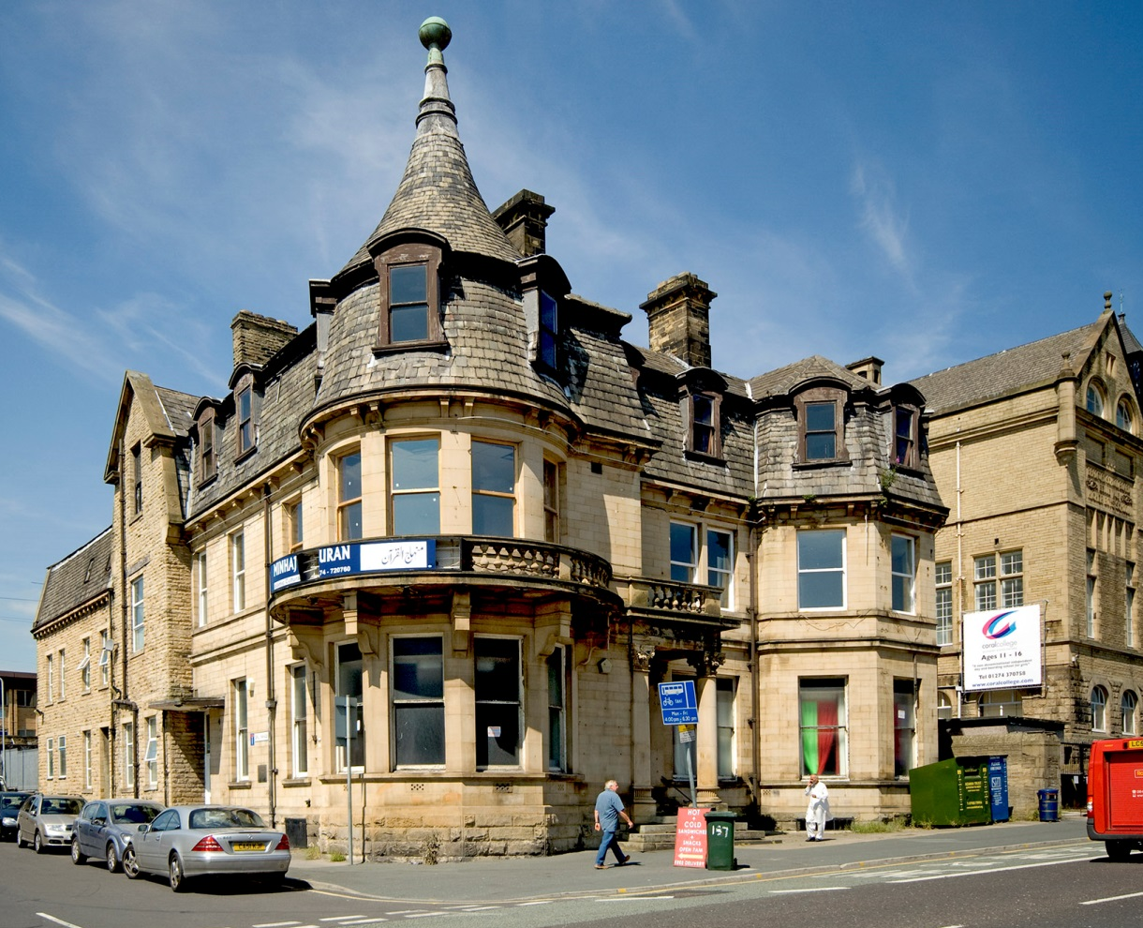
Minhaj-ul-Quran Mosque,
187 Manningham Lane, Bradford
The Belle Vue Hotel was built in 1874. Local soldiers used it as their pub and got drunk there.
In 1994 the Belle Vue pub closed and became an Indian restaurant.
Next to the building was a mosque. By 2018 it was shut up and for sale.
Notes:
Read out loud and/or print this slide at A4 to give out to pupils
Images:
Dp071723 © Historic England Archive

Slide 19
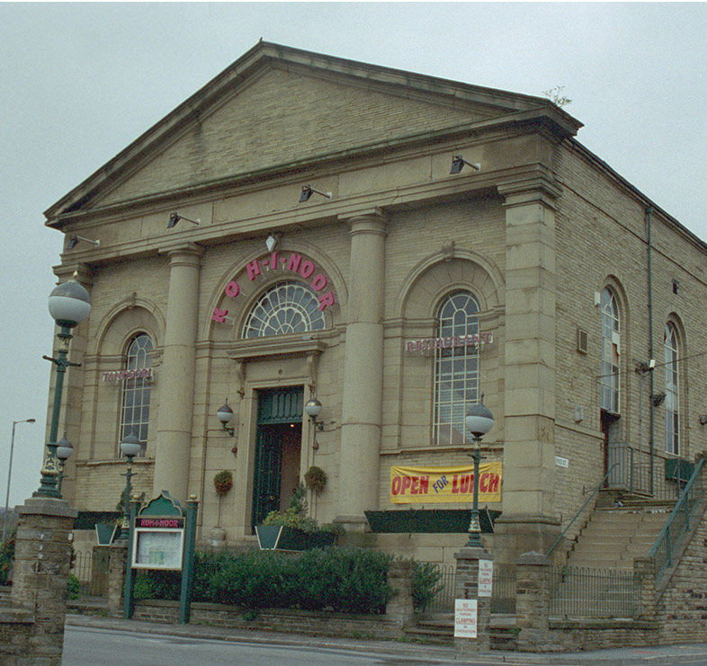
Shiny Stars Day Nursery,
Simes Street, Bradford
Built as St Andrews Chapel in 1849 for Scottish Protestant Christians (Scots moved to Bradford for work).
In 1982, the chapel closed when the Christians there went to join another church in Bradford.
The building became an Asian restaurant (as seen in this photo from 2001).
Later it became a nursery for children and their families. Families had to pay for their children to go there.
By 2018 the building was shut up and for sale.
Notes:
Read out loud and/or print this slide at A4 to give out to pupils
Images:
IOE01_05665_15 © Historic England Archive

Slide 20
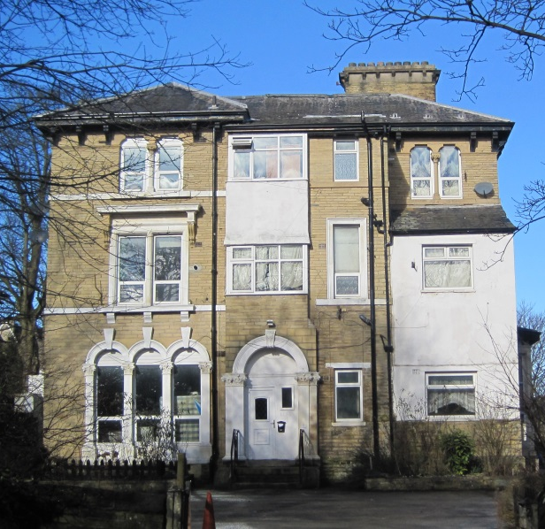
Former Carlton House,
1 Parkfield Road, Bradford
This Victorian building was once a private house for a rich family with servants.
In 1939, just before the Second World War started some Jewish people in Bradford bought the house and used it as a hostel (place to stay) for 25 Jewish boys who were rescued from the Nazis in Europe.
After the Second World War the house was opened as the Carlton Hotel where guests paid to spend the night.
The house was also once known as Carlton House. It was used for helping people get better from using drugs.
Now the house is divided in to flats.
Notes:
Read out loud and/or print this slide at A4 to give out to pupils

Slide 21
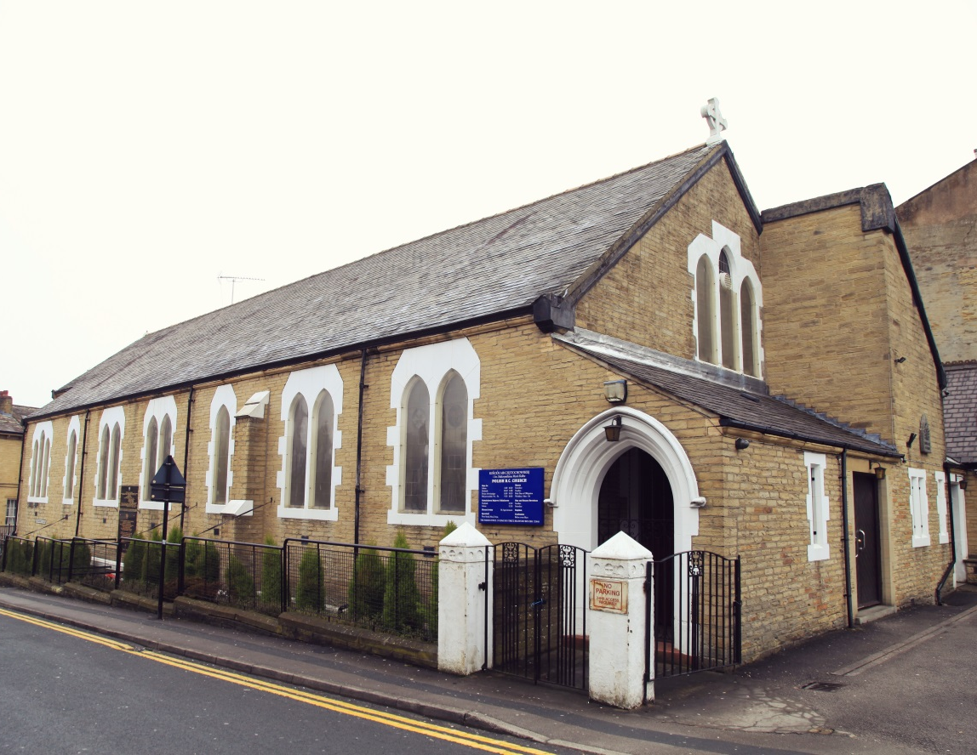
Polish Parish Church,
Edmund Street, Bradford
This Church was built in 1880. It was called the Catholic Apostolic Church.
In 1961 the church was hired by a group of Polish Roman Catholic Christians for worship (Poles settled in Bradford after the Second World War).
In 1971 the Poles bought the church and altered it for their use.
Notes:
Read out loud and/or print this slide at A4 to give out to pupils

Slide 22
Salts Mill,
Saltaire, Bradford
Salts Mill was built for Sir Titus Salt in 1853. It made different kinds of cloth. The mill was part of a special village called Saltaire built by Salt for his workers. He wanted them to live in decent houses and to be able to send their children to school.
From 1853-1986 Bradford people worked in the mill. Some families had come from other places in England, Scotland, Wales and Ireland.
After the Second World War workers from Europe and South Asia had jobs at Salts Mill.
In 1986 Salts Mill closed and the machinery was taken out.
In 1987 it re-opened as a tourist attraction with an art gallery and shops.
Notes:
Read out loud and/or print this slide at A4 to give out to pupils
Images:
aa010818 © Historic England Archive

Slide 23
Record Sheet
Building name:
Notes:
Blank Record Sheet – Print at A4 for pupils to fill in (enough to work in pairs or groups)
Remind pupils that once they’ve heard each building’s story they’re going to have to fill in a diagram like this one. They can write each different use into one of the inner segments.
You can either do this as a whole class activity, or once you’ve read through all 6 buildings together, split the class into 6 groups and give each group a printed copy of the information slide for one of the buildings and a blank copy of the Record Sheet with the diagram on.

Slide 24
Record Sheet
Building name: Tablighul Islam Mosque
Cinema
Example answer sheet
Bingo
club
Film
studio
Mosque
Notes:
Now briefly lead a discussion about the completed diagrams, ensuring that the different uses of the building have been labelled. Allow time for pairs/groups to read/listen to the remaining histories if you chose at the start to divide the class into 6 groups and only look at one building each, fill in copies of the segment diagram for each one.

Slide 25
What uses have our buildings had?
Cinema
Pub
Church
Bingo
club
Restau-
rant
Restau-
rant
Film
studio
Mosque
Mosque
Nursery
House
Church
Factory/
Mill
Hostel
Art
gallery
Hotel
shops
Notes:
Now briefly lead a discussion about the completed diagrams, ensuring that the different uses of the building have been labelled. Allow time for pairs/groups to read/listen to the remaining histories if you chose at the start to divide the class into 6 groups and only look at one building each, fill in copies of the segment diagram for each building.

Slide 26
What kind of places have these Bradford buildings been?
A place for meeting people in
A place to eat and drink in
A place to enjoy yourself in
A place to stay in for a while
A place to worship in
A place to gamble in
A place to buy and sell in
A place in live in as a home
A place to work in
A place to help sick people in
A place to learn in
A place to make things in
Notes:
Now ask pupils to think about the types of activity that have gone on in each – can they come up with a list. How does their list compare to the one here (using ‘fly-in’). Ask pupils to think if all these different uses could be grouped into different categories?

Slide 27
What uses have our buildings had?
Cinema
Pub
Church
Bingo
club
Restau-
rant
Restau-
rant
Film
studio
Mosque
Mosque
Nursery
Worship
Relax/enjoy
Work
Live
House
Church
Factory/
Mill
Hostel
Art
gallery
Hotel
shops
Notes:
Now try and simplify your list to fit the 4 categories (or create your own) – use pencils to shade in the segments of you diagrams depending on which category you think each use falls into. Once children have done their shading you can then discuss – for example is the Nursery a place to work or a place to relax/ enjoy, same with the shops etc. Think about how a building have a different uses for different people at the same time – school is a place for them to learn and place for teachers to work etc.

Slide 28
What uses have our buildings had?
Cinema
Pub
Church
Bingo
club
Restau-
rant
Restau-
rant
Film
studio
Mosque
Mosque
Nursery
Worship
Relax/enjoy
Work
Live
House
Church
Factory/
Mill
Hostel
Art
gallery
Hotel
shops
Notes:
Extension Activity – Pupils could put the dates/periods for each use in the outer segment of the wheel – then they could look in more detail at how uses have changed over time in a more specific way. They could try to spot patterns in the changes of use and think about why these changes happened. This idea of ‘why’ Bradford changed is covered more thoroughly in the Lesson 2 PPT https://historicengland.org.uk/content/docs/education/explorer/bradford-over-time-lesson-two

Slide 29
What uses have our buildings had?
Cinema
Pub
Church
Bingo
club
Restau-
rant
Restau-
rant
Film
studio
Mosque
Mosque
Nursery
Worship
Relax/enjoy
Work
Live
House
Church
Factory/
Mill
Hostel
Art
gallery
Hotel
shops
Notes:
Plenary or Concluding Activity
Lead discussion about the uses that different buildings have been put to at different times, taking comments from different pairs/small groups. Allow pupils to challenge the conclusions of different pairs/groups. Lastly lead discussion about which buildings appear to have changed the most and least (this can be supported by referring to the number of inner segments on each diagram that pupils coloured previously).

Slide 30
Find more teaching resources at:
HistoricEngland.org.uk/Education

