Slide 1

What can Barrow’s buildings tell us about the story of our town?
Recap and Reflect PPT

Slide 2
What can Barrow’s buildings tell us about the story of our town?
Key Stage 2
To develop pupils’ knowledge of significant places, people, events and themes in Barrow’s history.
To support pupils in using the built historic environment as historical evidence to find out about an area in the past
To build pupils’ sense of place and pride in their local area.

Slide 3
How to use this PPT
This PowerPoint is part of the learning resource: What can Barrow’s buildings tell us about the story of our town? Teachers should use this PPT, after having taken pupils on the trail of the same name.
This PPT can be used to revisit pupils learning from the trail and to support pupils in drawing conclusions about the main enquiry question: What can Barrow’s buildings tell us about the story of our town?
Teachers can use all, or some of the slides, and can edit them to meet the needs of pupils.
Introductory PPT
Heritage trail route map and script for teachers
Heritage trail worksheet for pupils
Additional Activities PPT
Colour and cut activity sheets PDF

Slide 4
What can Barrow’s buildings tell us about the story of our town? Recap and Reflect
In this lesson we will:
Remind ourselves about what we learnt when we went on our history trail around Barrow centre.
Think about what these sites tell us about the story of our town and why it is special.
Revisit our thoughts and feelings about Barrow from our first lesson about the trail.

Slide 5


What can you remember about the trail? Sites we visited
We recently went on a history trail around the centre of Barrow.
Can you remember the names of any of the buildings and sites we visited?
Which site did you find most interesting site and why?
Think-Pair-Share

Slide 6
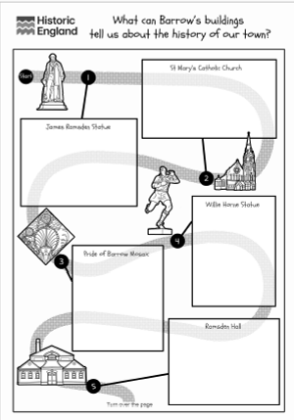
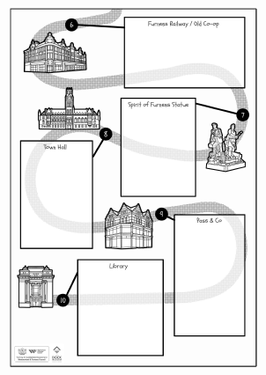


What can you remember about the trail? Information about each site
What can you remember? Worksheet
Complete the worksheet on the next slide. Write down as much as you can remember about each site that we visited on the trail.
Write
You can write words or whole sentences.
What can you remember? Worksheet

Slide 7
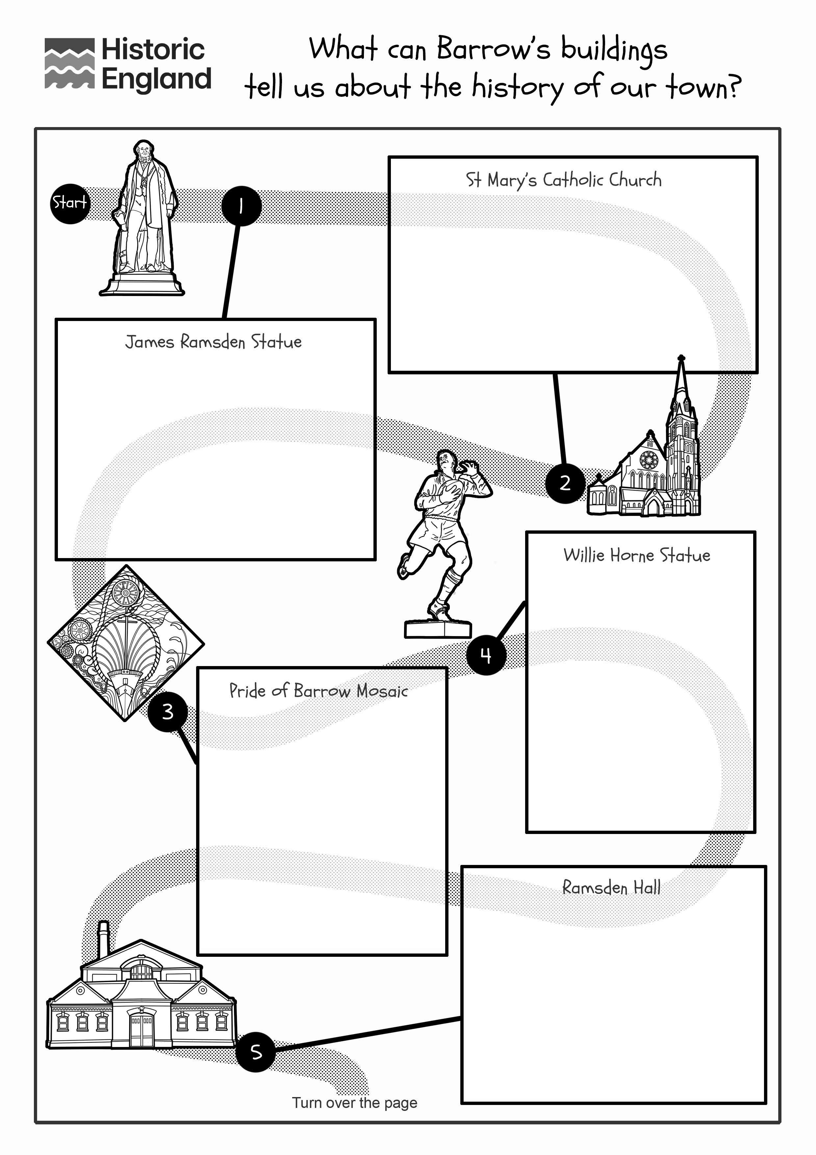
Barrow Trail worksheet (1)

Slide 8
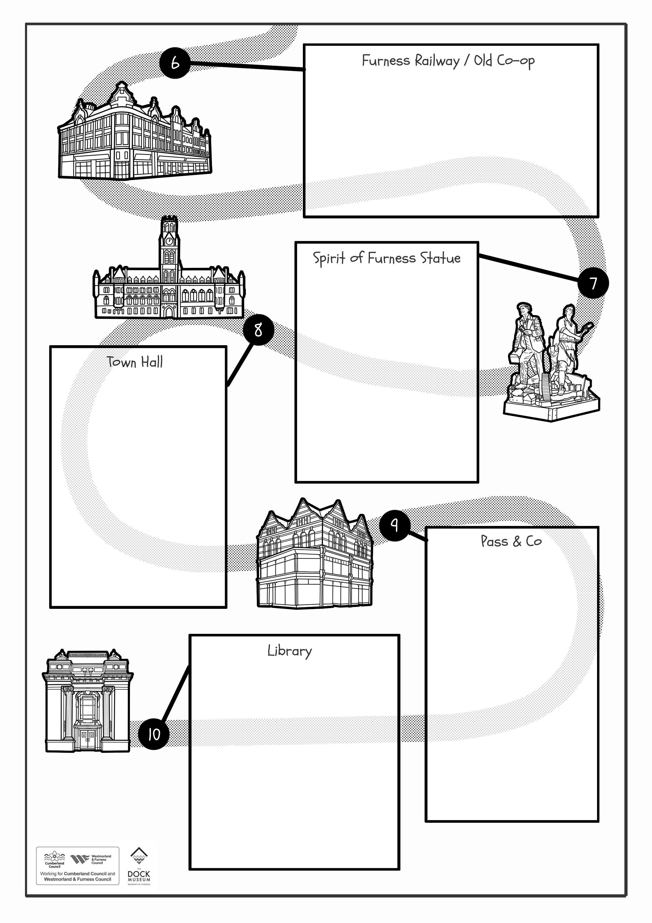
Barrow Trail worksheet (2)

Slide 9
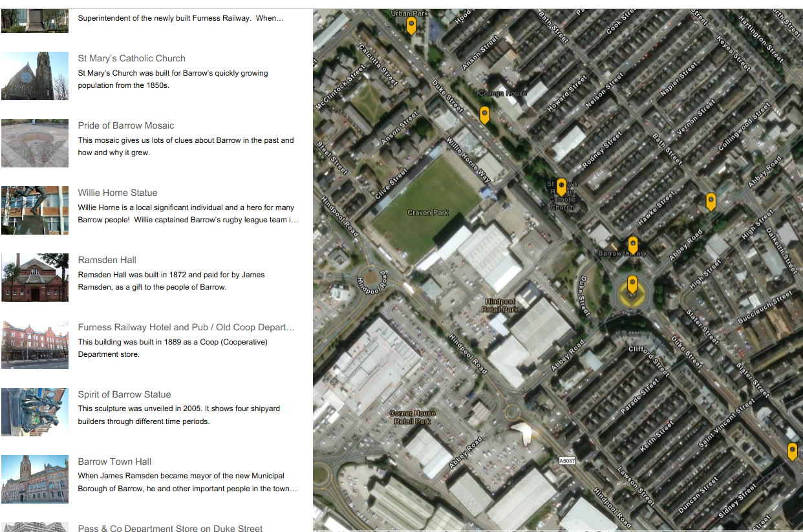
Trail StoryMap
Use the StoryMap to remind yourself of the sites that you visited on the trail and the information about each one.
Write
Can you add any more information to your worksheet?
What can Barrow’s buildings tell us about the story of our town StoryMap
Notes:
You could do this as a class, or you could explore the map independently, in pairs or in small groups. You could also explore the StoryMap at home. - https://storymaps.arcgis.com/stories/a0c835ad08a343f0b6f306d845b153f1

Slide 10

Using the trail to understand Barrow’s Story
When we first found out about the Barrow history trail, we said that the sites on the trail would help us to understand the story of Barrow.
Explain
Complete the table shown on the next slide to record what each building or site tells us about Barrow’s story.

Slide 11
What can Barrow’s buildings tell us about the story of our town? (2)
Building / Site | What does this building tell us about Barrow’s story? | Building / Site | What does this building tell us about Barrow’s story?
James Ramsden Statue |  | Old Coop/ Furness Railway Pub
St Mary’s Church |  | Spirit of Barrow Statue
Spirit of Barrow Mosaic |  | Barrow Town Hall
Willie Horne Statue |  | Pass and Co Department Store
Ramsden Hall |  | Barrow Library and Archive

Slide 12


Using the trail to think about what makes Barrow special
When we first found out about the Barrow history trail, we said that understanding the story of Barrow would help us appreciate why Barrow is special.
Revisit the mind map you made when we were thinking about the question “What does Barrow mean to me?”
Write
Can you add more words, phrases, people and places?
You might like to use a different coloured pen or pencil.
Group Discussion
Compare with your classmates: Has your understanding of Barrow’s story changed your feelings about the town?

Slide 13

Reflection
You have been asked by the Dock Museum in Barrow to design the contents of a new display, explaining the reasons why Barrow is such an interesting and special town.
Choose up to 5 things to include in your exhibition. For each one, explain what you have chosen and why.
You might like to include:
Objects (for example a piece of iron ore)
Photos of buildings, places or people
Artwork (your own or someone else's

